Slide 1





Exciting team building games to improve collaboration
2523 Lytvynova Anastasia, Fomenko Ksenia, Loza Alisiia
START

Slide 2
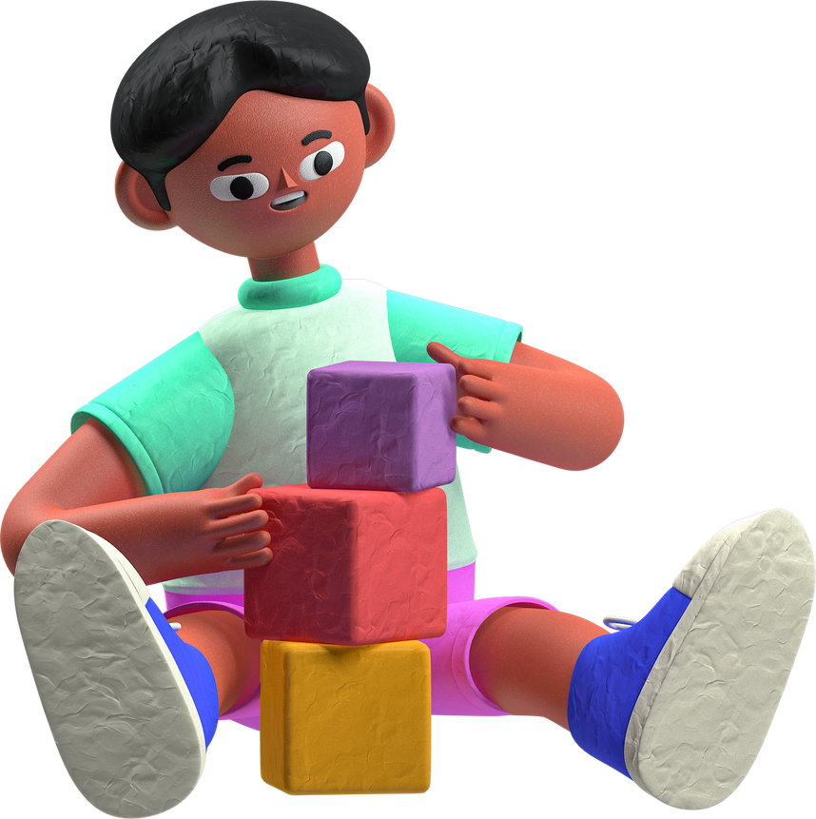

Team building is a management technique used to increase the efficiency and productivity of work groups through various activities. In today’s interconnected and fast-paced world, effective teamwork is more critical than ever.

Slide 3
How Games Enhance Teamwork
Fostering a Positive Atmosphere
Building Trust
Boosting Empathy and Understanding
Improving Communication
Encouraging Problem-Solving

Slide 4

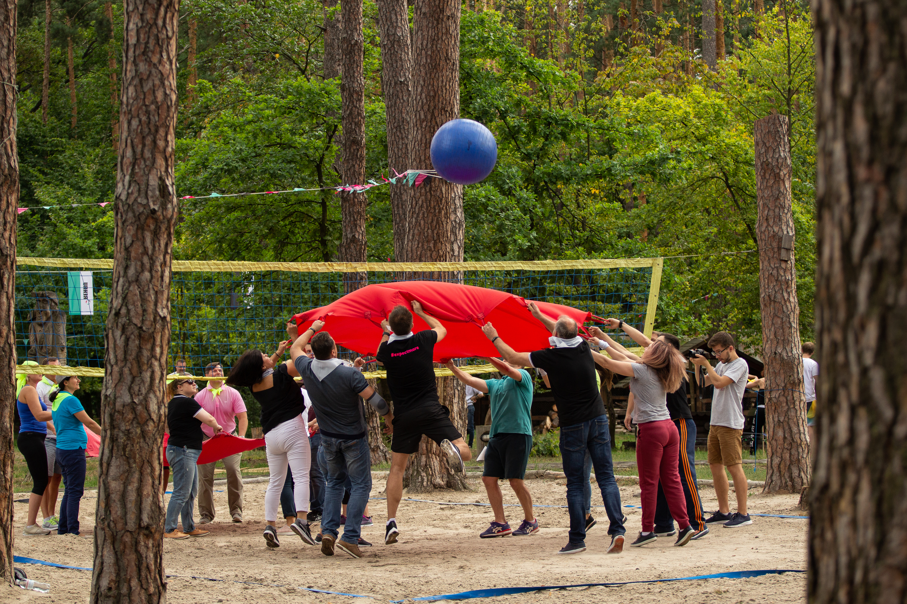


LLC "LEROY MERLIN UKRAINE"
The company «Leroy Merlin Ukraine», known for its professionalism, participated in team building games and this became for the company not only an interesting challenge, but also an opportunity to strengthen the team, develop cooperation skills and increase employee motivation.

Slide 5
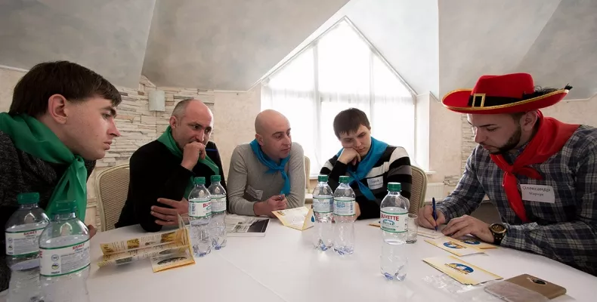

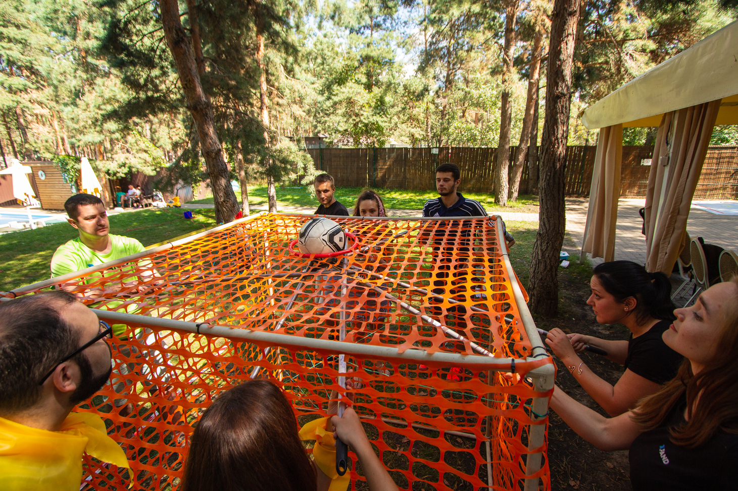
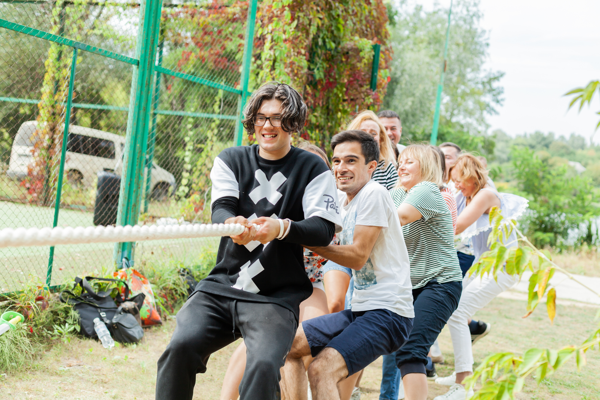
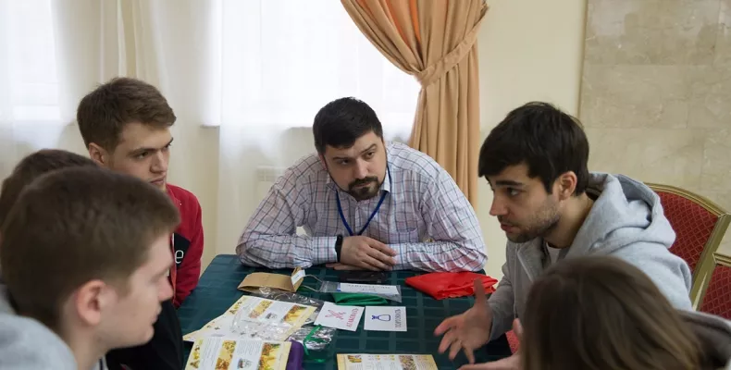

Slide 6
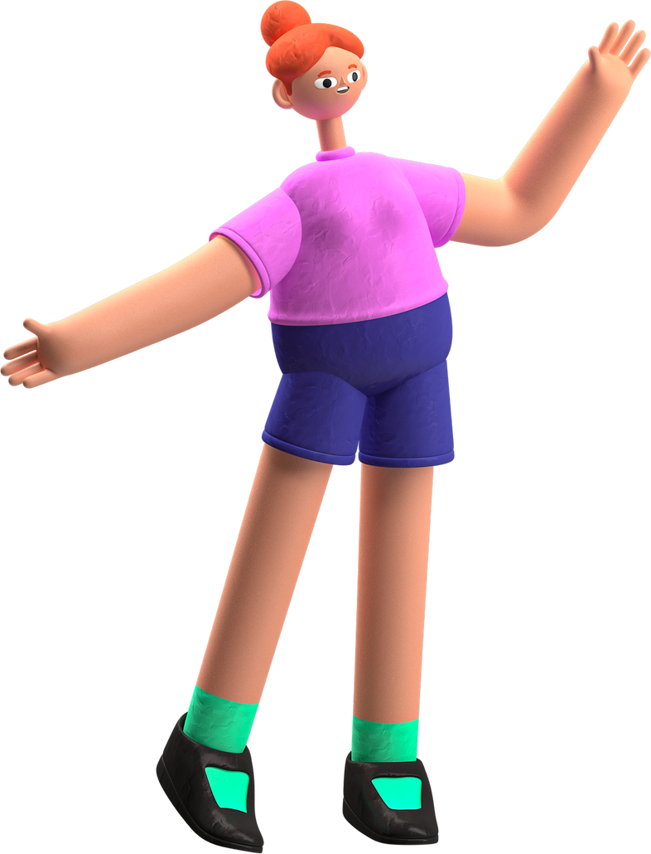


CIVITTA Company
The leading consulting company «CIVITTA», known for its commitment to innovation and team development, took part in team building games organized in the picturesque Glibivka complex by «Lioncom», a company specializing in organizing corporate events.

Slide 7
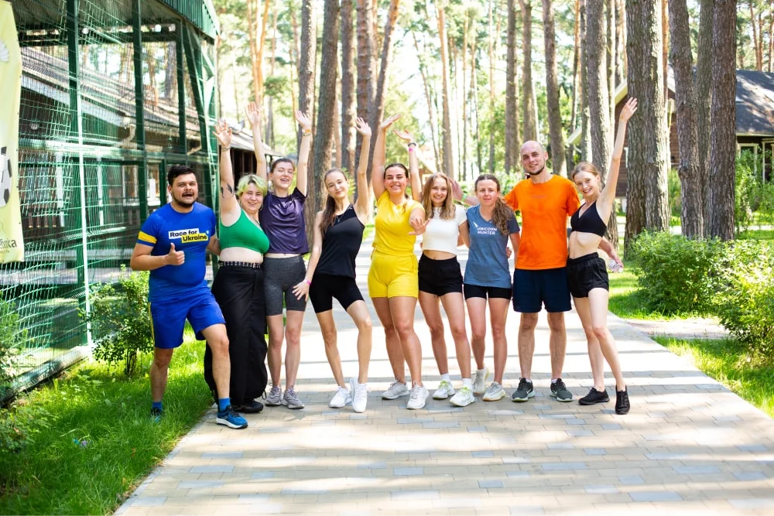

Slide 8
Conclusion
Team-building games are a powerful tool for fostering collaboration, trust, and communication among team members.

Slide 9
http://pev.kpu.zp.ua/journals/2020/3_20_ukr/29.pdf
Sources :
https://teammaster.pro/ua
https://lioncom.pro/

