Slide 1
International communication as a way to lead a successful business
By Kurdiukova Sofiia and Ursolova Angelina
2523
2024

Slide 2

In international business,
effective communication
is essential for building trust, understanding, and cooperation among diverse stakeholders, such as customers, suppliers, partners, employees, and regulators.
This presentation explores the benefits of effective communication in international business and strategies to overcome barriers.

Slide 3
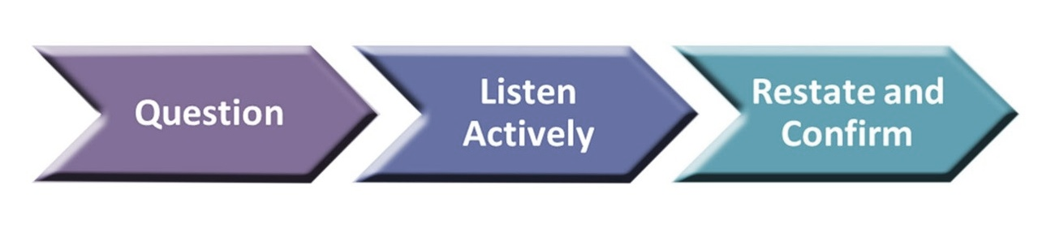
Benefits of Effective Communication
Enhanced customer satisfaction and loyalty
Improved collaboration and innovation
Reduced costs and risks
Builds strong, lasting partnerships
Positions the company as a culturally aware global leader
Some of the benefits of effective communication in international business are:

Slide 4
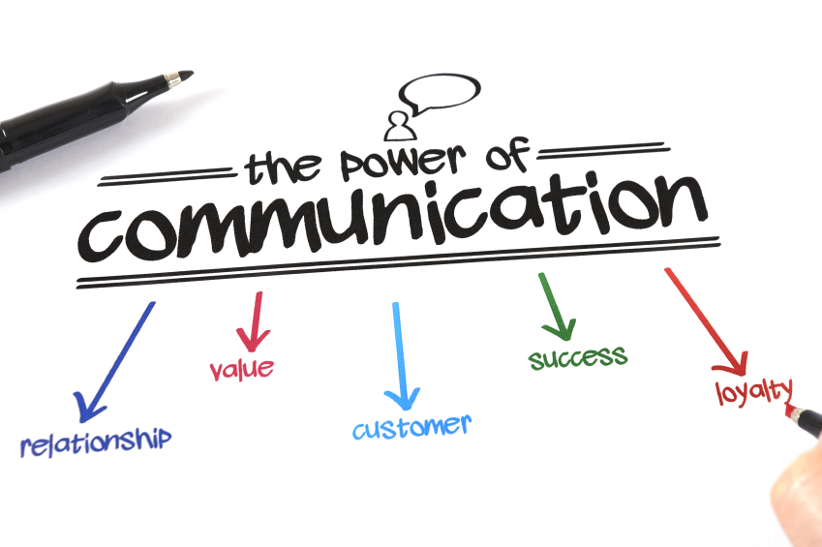
International Communication Strategies

Slide 5


International Communication Strategies
Key strategies
Clear and Concise Messaging: Monobank
Feedback Loop: MakeUp
Clear and Concise Messaging: use simple, clear, and concise language that can be easily understood by your audience. Avoid jargon, slang, idioms, and acronyms.
Feedback Loop: communication isn’t one-way; seek and provide constructive feedback to strengthen relationships.
Post-Purchase Survey: After customers receive their products, they are sent an email survey asking about their experience with shipping, packaging, and product quality.
Monobank communicates with customers using short and clear push notifications in its app, such as balance updates or reminders for credit payments.

Slide 6


International Communication Strategies
Non-verbal Communication
Non-verbal Communication: Halia Baluvana
Active Listening: SoftServe
Nonverbal Communication: be aware of body language, facial expressions, and gestures.
Active Listening: focus on understanding not just words, but underlying emotions and context.
Halia Baluvana
Employee Presentation: Staff at events or in stores maintain friendly and approachable body language, embodying the brand’s commitment to a welcoming customer experience.
A leading Ukrainian IT company, excels in Active Listening because of its client-centric approach to business. This category aligns with the company's focus on understanding customer needs and creating tailored solutions.

Slide 7


International Communication Strategies
Adaptability
Adaptability Across Channels: Nova Poshta
Cultural Sensitivity: "Ukrainian Institute" project
Adaptability Across Channels: tailor your message to the medium (email, video calls, meetings).
Cultural Sensitivity: understand the cultural norms and values that affect communication and decision-making.
As a global logistics provider effectively manages communication across diverse channels, adapting to customer and business needs.
The Ukrainian Institute actively promotes Ukrainian culture abroad through the organization of exhibitions, cultural events and art programs in various countries of the world. One of the main goals is the formation of a positive image of Ukraine in the world, support of Ukrainian artists and cultural figures in the international arena.
Nova Poshta integrates phone, email, and chatbot support to address various customer preferences efficiently.

Slide 8

Challenges and Solutions
in international business communication

Slide 9
Challenges
in international communication
Language Barriers:
Non-verbal Communication:
Cultural Norms and Values:
High- vs. Low-Context Cultures
Time Zones/ Scheduling:
Conflict Resolution:
misunderstanding due to different languages and lack of translation services.
cultural differences in gestures and body language can lead to misinterpretation.
differences in hierarchy, decision-making, and etiquette.
communication styles vary: high-context cultures rely on implicit cues, while low-context cultures value direct communication.
coordinating meetings across different time zones can create scheduling conflicts.
addressing conflicts constructively with effective communication skills.

Slide 10

Solutions to Communication Barriers
Train employees in cultural awareness and sensitivity.
Invest in professional interpreters or multilingual staff.
Schedule meetings flexibly to accommodate international partners.
Use conflict resolution strategies such as active listening and empathy.

Slide 11
By mastering
30 %
25 %
Adaptability
Clear messaging
10 %
10 %
Cultural sensitivity
Active listening
20 %
5 %
???
???
companies can foster innovation and achieve lasting success.

Slide 12

International communication as a way to lead a successful business
International communication is a vital tool for thriving in today’s interconnected business environment. By mastering clear messaging, active listening, adaptability, and cultural sensitivity, companies can bridge cultural divides, build strong relationships, and unlock opportunities in global markets.
These skills not only minimize misunderstandings and foster trust but also drive innovation by merging diverse perspectives. Ultimately, effective international communication empowers businesses to achieve lasting success and cultivate meaningful connections in a dynamic, globalized world.

Slide 13

Your time is valuable, and we’re grateful you chose to spend it listening to us

